Slide 1
Water use in Australia

Slide 2
Making a pie chart
We need an easy way of displaying the water consumption per state or territory in Australia
A pie chart is a really good way to show relative sizes
It means we can see at a glance which one uses the most water

Slide 3
Your Task
Create a pie chart using the information you have been given.
Use the following steps to help you:

Slide 4
Step 1
Put your data into a table like the one below:
WA | SA | TAS | VIC | NSW | QLD | Total

Slide 5
Step 2
Next, divide each value by the total and multiply by 100 to get a percent:
WA | SA | TAS | VIC | NSW | QLD | Total
1.4 | 1.1 | 0.5 | 2.4 | 4.3 | 3.1 | 12.8
1.4/12.8x100 = | 1.1/12.8 x100 = | 0.5/12.8 x100 = | 2.4/12.8 x100 = | 4.3/12.8 x100 = | 3.1/12.8 x100 = | 100%
Notes:
To one decimal place

Slide 6
Step 3
We need to figure out how many degrees for each sector. A Full Circle has 360 degrees, so we do this calculation:
WA | SA | TAS | VIC | NSW | QLD | Total
1.4 | 1.1 | 0.5 | 2.4 | 4.3 | 3.1 | 12.8
1.4/12.8x100 =10.9% | 1.1/12.8 x100 =8.6% | 0.5/12.8 x100 =3.9% | 2.4/12.8 x100 =18.8% | 4.3/12.8 x100 =33.6% | 3.1/12.8 x100 =24.2% | 100%
10.9x3.6° = | 8.6x3.6° = | 3.9x3.6° = | 18.8x3.6° = | 33.6x3.6° = | 24.2x3.6° = | 360°
Notes:
To two decimal places.

Slide 7
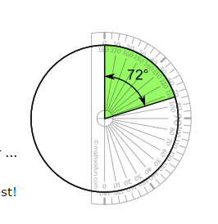
Step 4
Now you are ready to start drawing.
Draw a circle then use your protractor to measure the degrees of each sector.

Slide 8
WELL DONE!
You can now draw a pie chart!!
What does the pie chart you have drawn tell you about water usage in Australia?

